Slide 1
Introduction
Wireless communication is one of the fastest-growing technologies
The demand for connecting devices without the use of cables is increasing everywhere
Wireless LANs can be found on college campuses, in office buildings, and in many public areas

Slide 2
Architectural Comparison
Architecture comparison of wired and wireless LANs
Medium
Hosts
Isolated LANs
Connection to other Networks
Moving between Environments

Slide 3
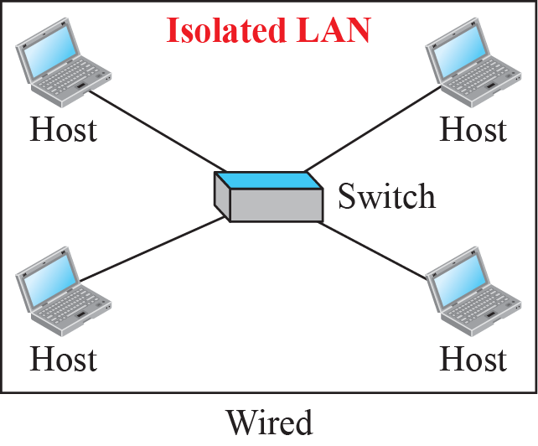
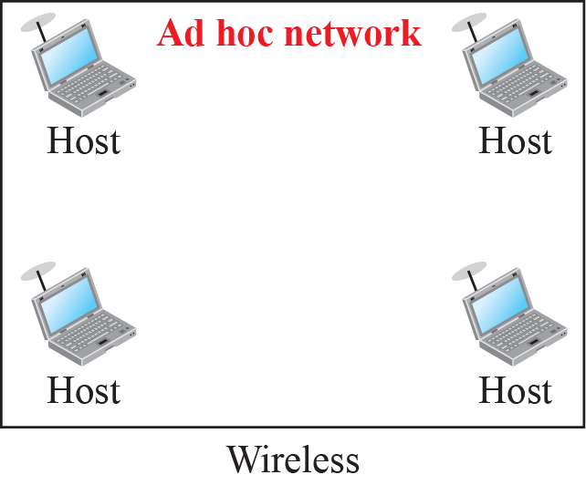
Isolated LANs: Wired versus Wireless

Slide 4
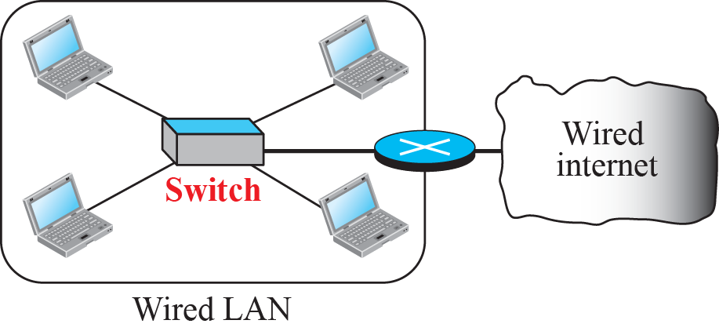
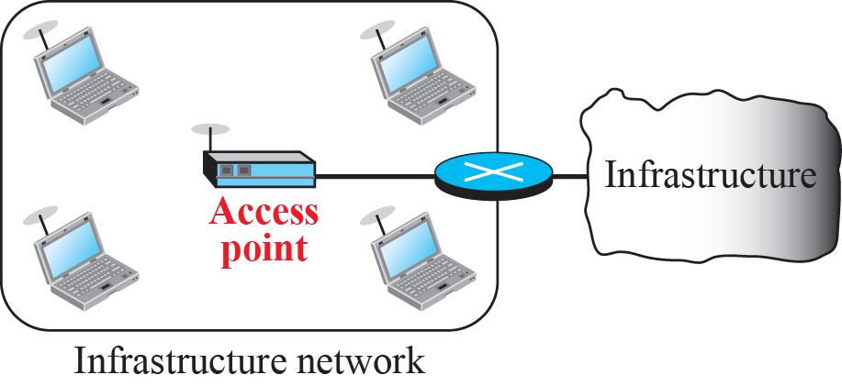
Connection of a Wired/Wireless LAN to other networks

Slide 5
Characteristics of a Wireless LAN
Several characteristics of wireless LANs either do not apply to wired LANs or the existence of these is negligible and can be ignored
Attenuation
Interference
Multipath Propagation
Error

Slide 6
Access Control
Most important issue in a wireless LAN is how a wireless host can get access to the shared medium (air)
CSMA/CD does not work in wireless LANs for three reasons:
Wireless hosts don’t have power to send and receive at the same time

Slide 7
Access Control
The hidden station problem prevents collision detection
The distance between stations can be large

Slide 8
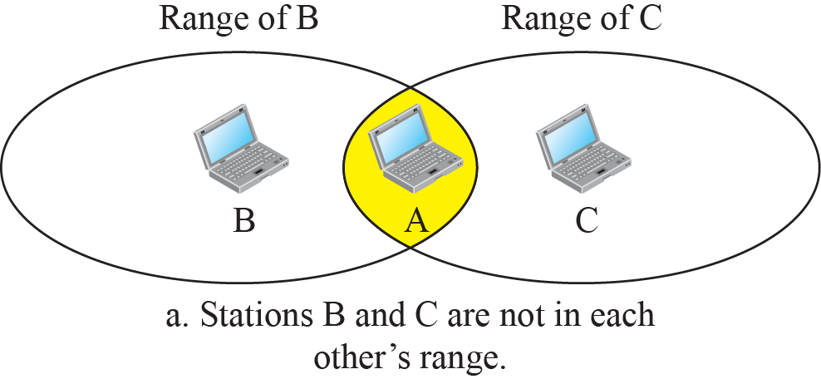
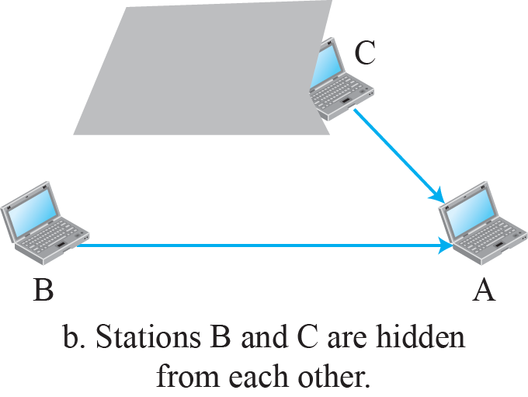
Hidden Station Problem

Slide 9
IEEE 802.11 PROJECT
IEEE has defined the specifications for a wireless LAN, called IEEE 802.11, which covers the physical and data-link layers
It is sometimes called Wireless Ethernet
The term WiFi (short for wireless fidelity) as a synonym for wireless LAN (certified by WiFi alliance)

Slide 10
Architecture
The standard defines two kinds of services:
The basic service set (BSS); and
The Extended service set (ESS)

Slide 11
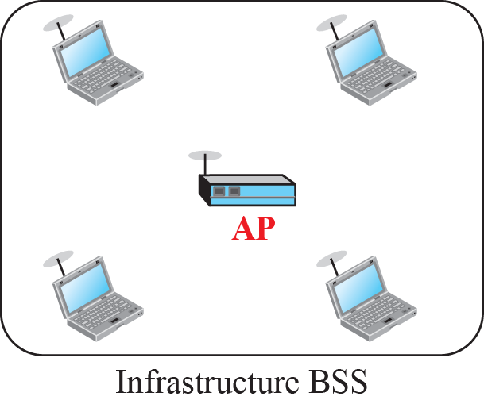
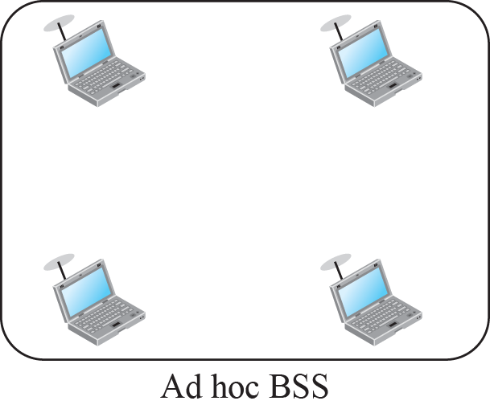
Basic Service Sets (BSSs)

Slide 12
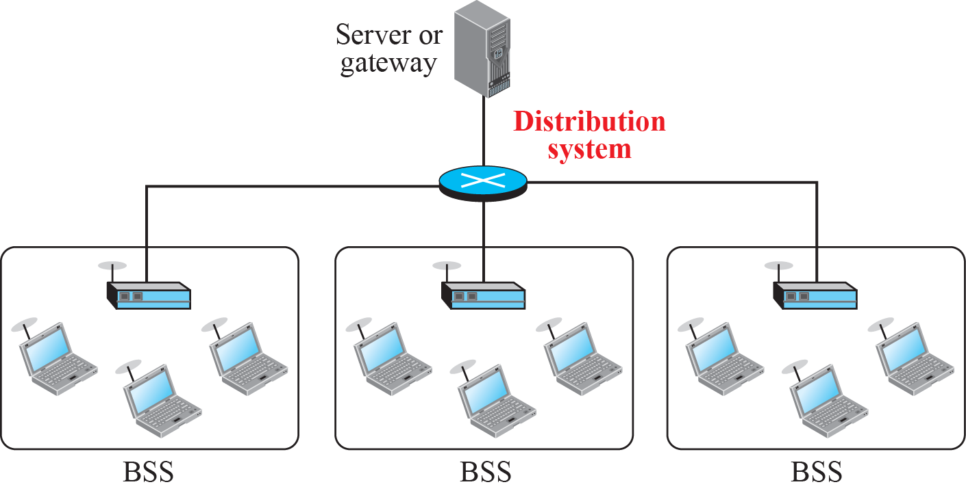
Extended Service Set (ESS)

Slide 13
Types of Stations
No-Transition
Mobility
BSS-Transition Mobility
ESS-Transition Mobility

Slide 14
MAC Sub-layer
IEEE 802.11 defines two MAC sub-layers:
The Distributed Coordination Function (DCF) ; and
The Point Coordination Function (PCF)

Slide 15
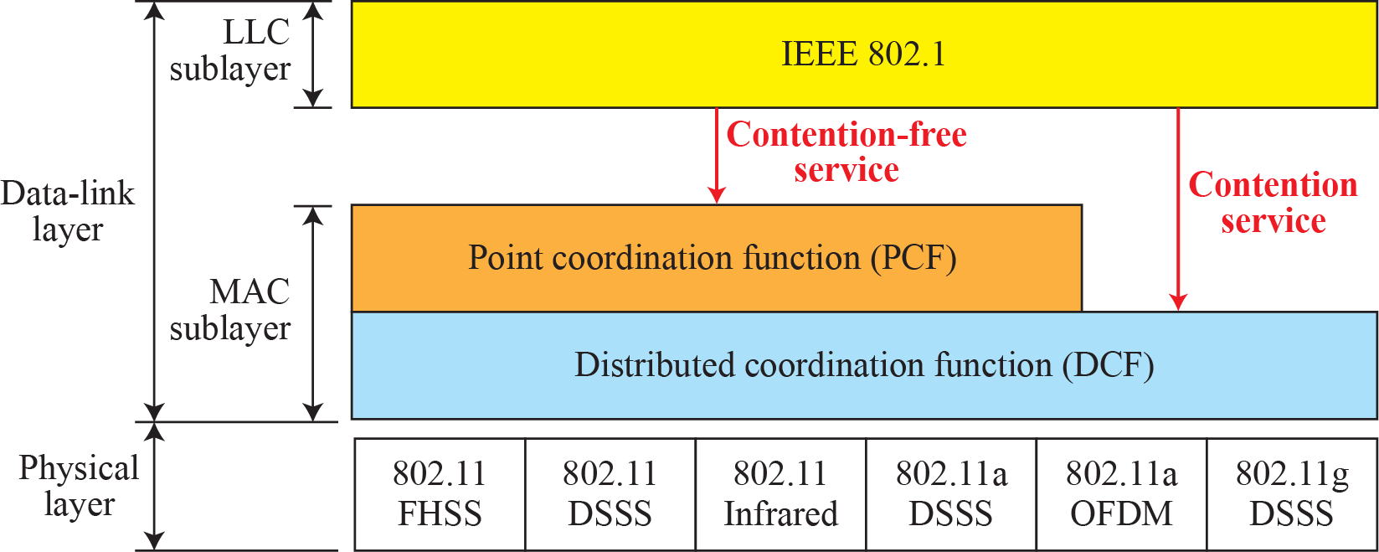
MAC Layers in IEEE 802.11 Standard

Slide 16

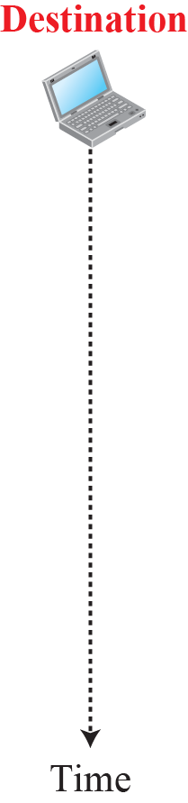










CSMA/CA and NAV

Slide 17
MAC Sub-layer
IEEE 802.11 defines two MAC sub-layers:
The Distributed Coordination Function (DCF) ; and
The Point Coordination Function (PCF)

Slide 18

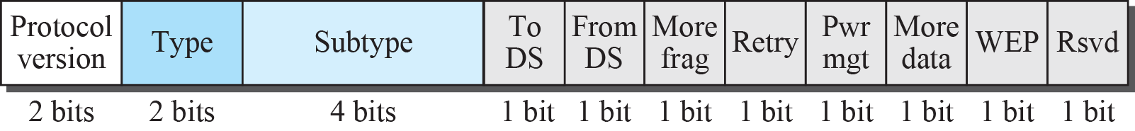
Frame Format

Slide 19
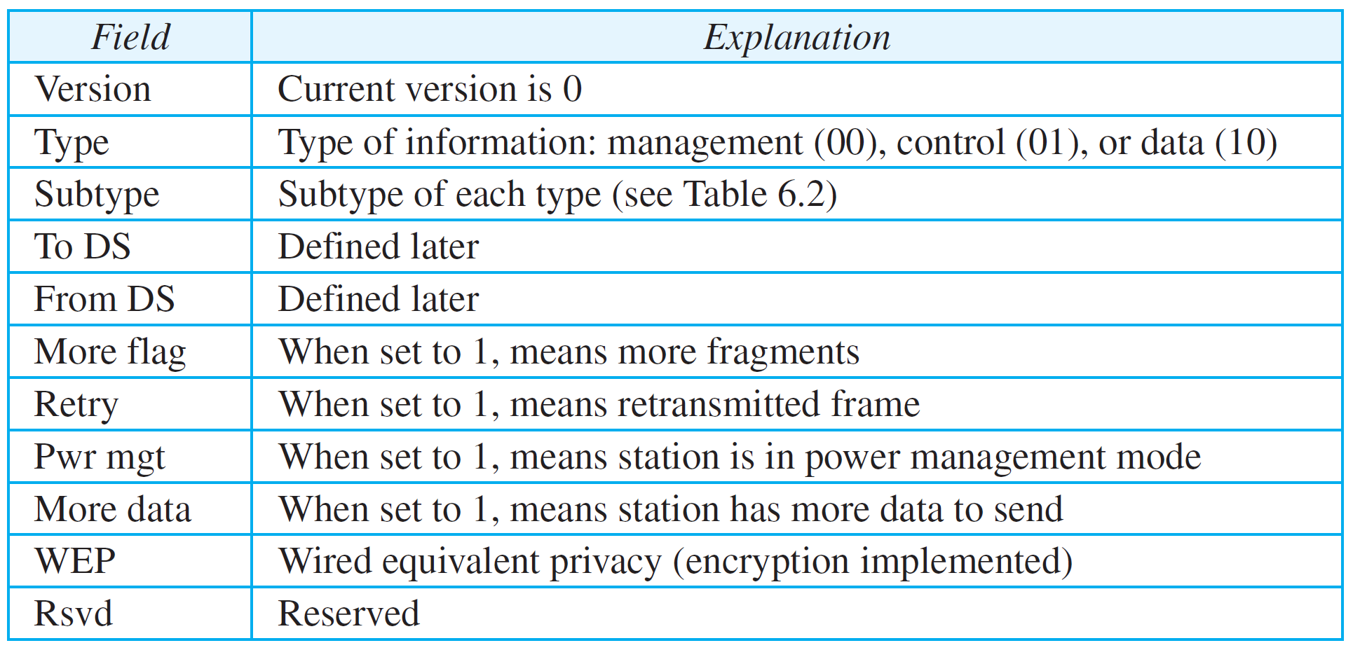
Subfields in FC field

Slide 20
Frame Types
Management Frames
Control Frames
Data Frames

Slide 21
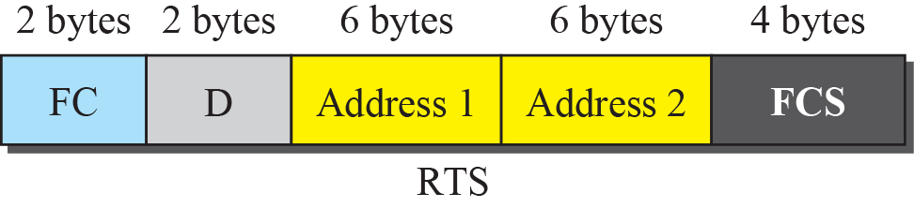
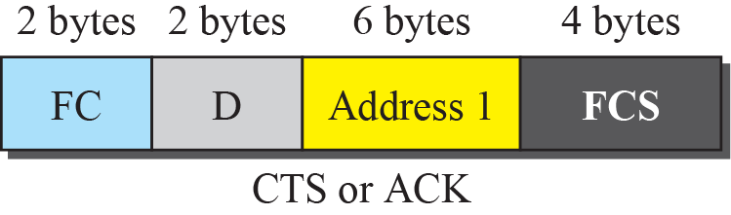
Control Frames

Slide 22
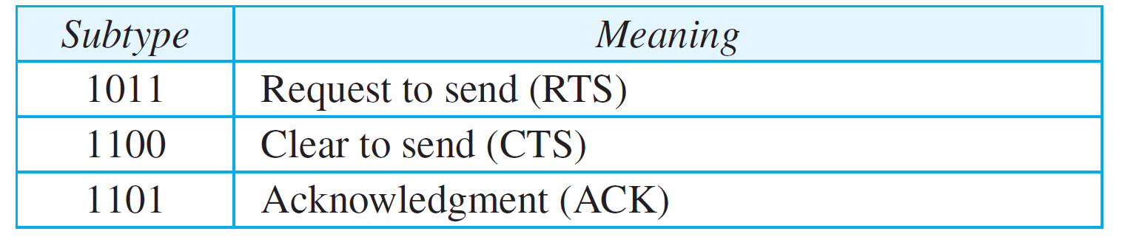
Values of Subfields in Control Frames

Slide 23
Physical Layer
All physical implementations, except the infrared, operate in the industrial, scientific, and medical (ISM) band, which defines 3 unlicensed bands in 3 ranges:
902–928 MHz
2.400–4.835 GHz
5.725–5.850 GHz

Slide 24
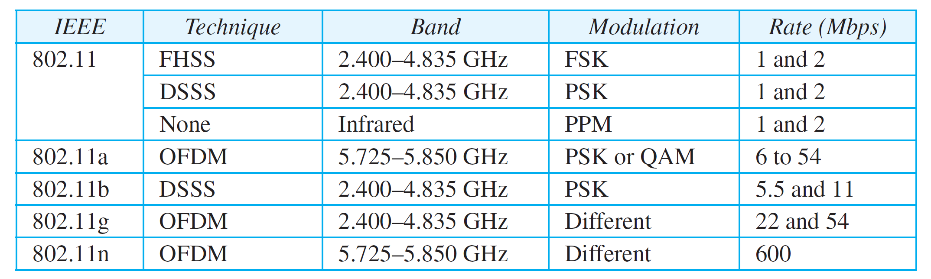
Specifications

Slide 25
BLUETOOTH
Bluetooth is a wireless LAN technology designed to connect devices of different functions when they are at a short distance from each other
A Bluetooth LAN is an ad hoc network
The devices, sometimes called gadgets, find each other and make a network called a Piconet

Slide 26
Architecture
Bluetooth defines two types of networks:
Piconet
Scatternet

Slide 27
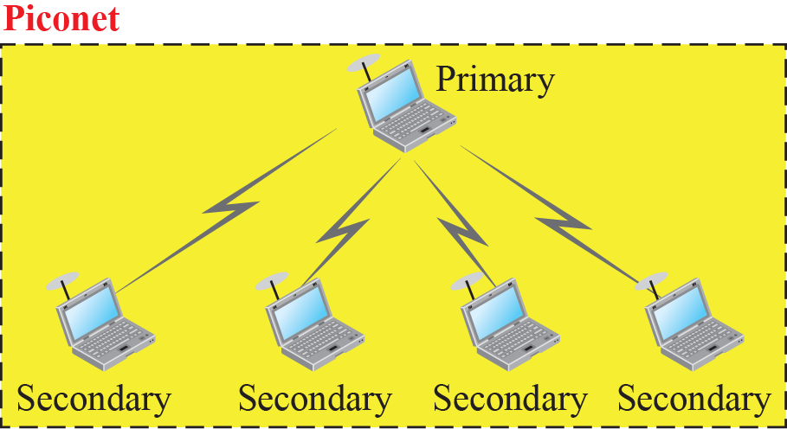
Piconet

Slide 28
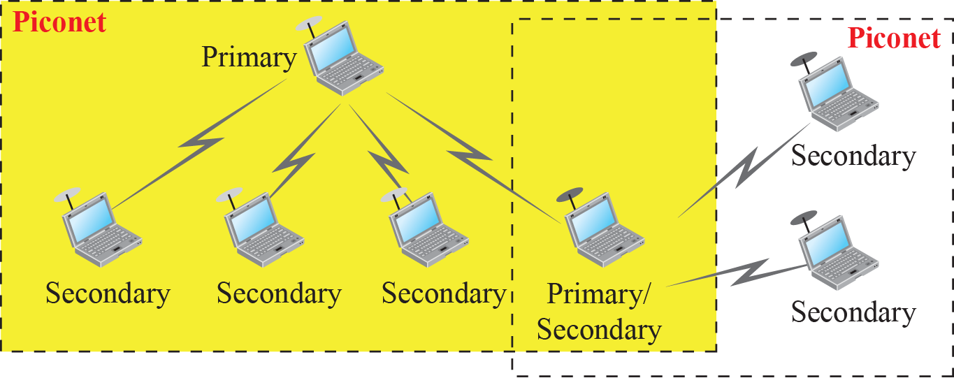
Scatternet

Slide 29
Bluetooth Layers
Bluetooth uses several layers that do not exactly match those of the Internet model we have defined in this book

Slide 30
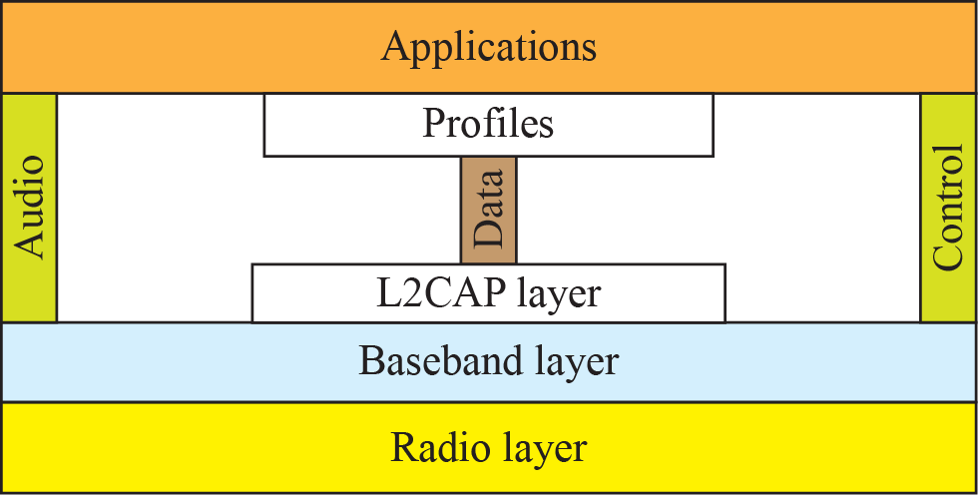
Bluetooth Layers

Slide 31
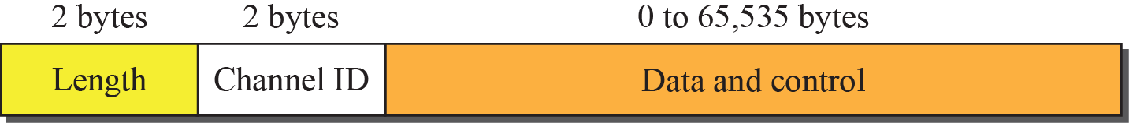
L2CAP Data Packet Format

Slide 32
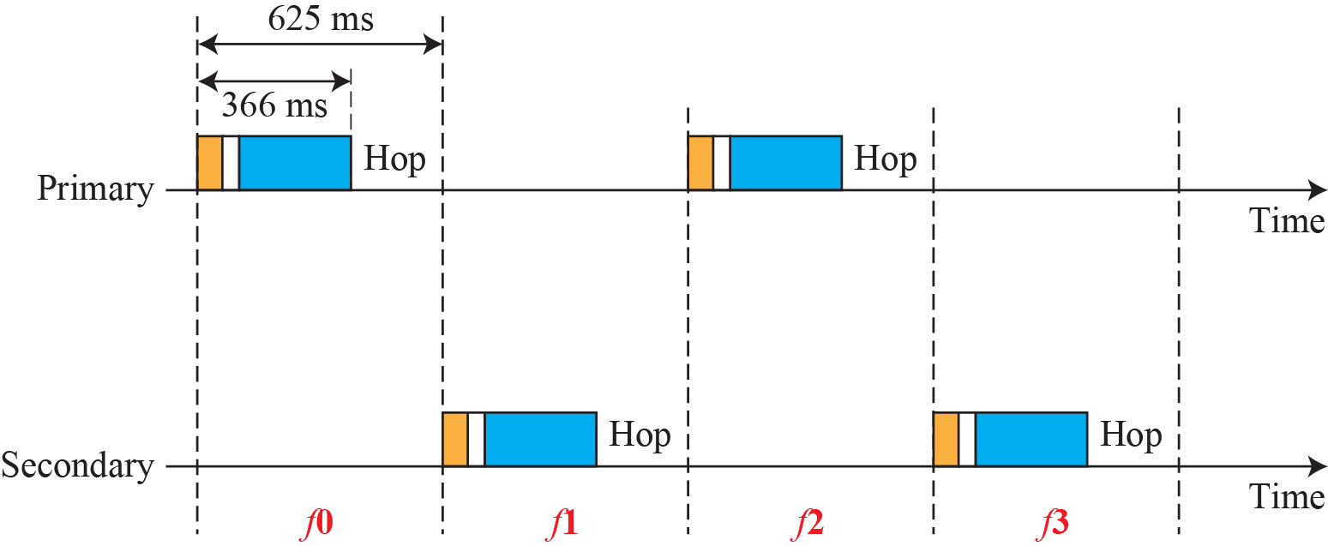
Single-Secondary Communication

Slide 33
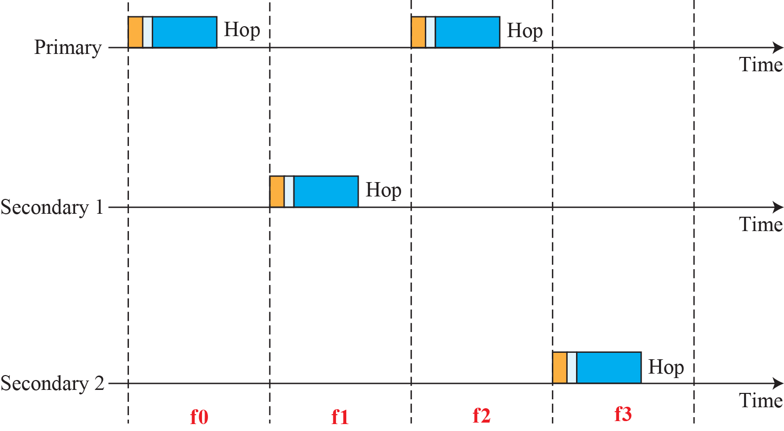
Multiple-Secondary Communication

Slide 34
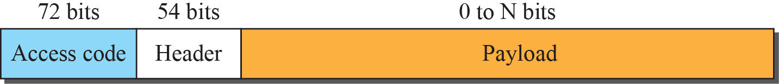

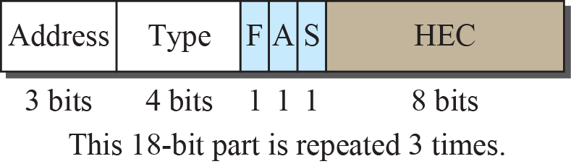
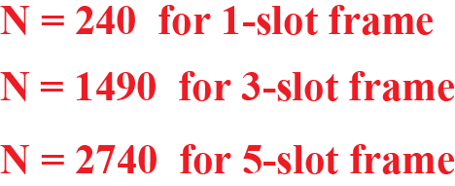
Frame Format Types

